Slide 1
Machine Learning in Astronomy
28/10/20
By
Chen Ostrovski

Slide 2
Machine learning in astronomy
Astronomy is rich with data. Data volumes of entire surveys a decade ago can now be acquired in a single night and real-time analysis is often desired, thus modern astronomy demands highly efficient machine learning and image analysis algorithms.
In this seminar we will focus on exemplary results, discuss main challenges and highlight some recent methodological advancements in machine learning and image analysis triggered by astronomical applications.
Main topic:
Distinguishing stars from quasars

Slide 3
TABLE OF CONTENTS
01
02
03
04
Introduction
incoming data
Process data
Classification
Basic concepts in Astronomy and
Machine Learning
Telescopes and Spacecraft
Machine Learning
Algorithms
Distinguishing Stars from Quasars
Analysis of results

Slide 4
01
Introduction
Basic concepts in Astronomy and
Machine Learning

Slide 5
Introduction
Astronomy
Machine Learning
Branch of the natural sciences that investigates and observes the motion, structure, formation, and evolution of celestial bodies and the universe through observations and analysis.
Study of computer algorithms that improve automatically through experience.

Slide 6
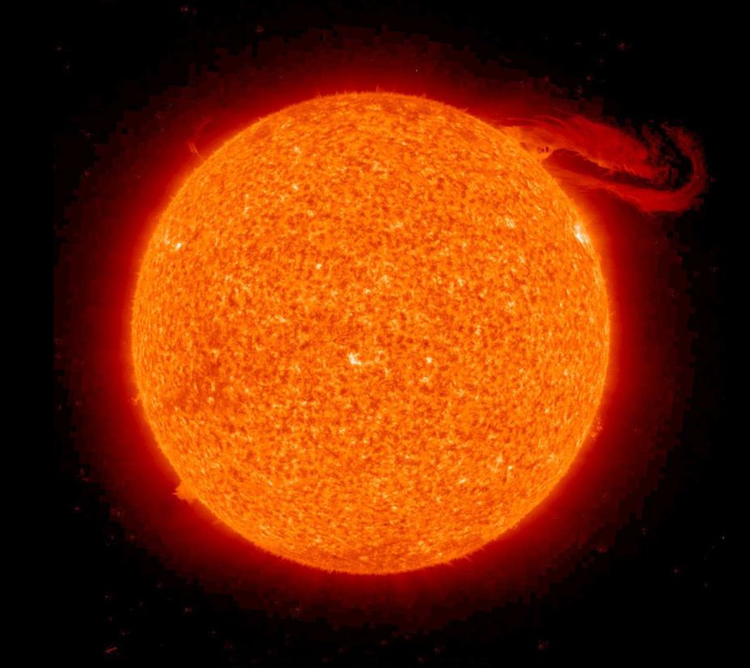
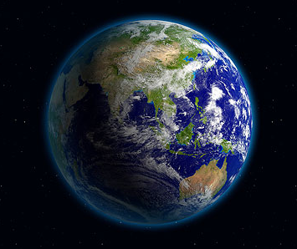
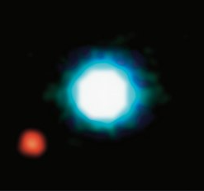
Astronomical objects
Star
Planet
Exoplanet
Astronomical object consisting of a luminous spheroid of plasma held together by its own gravity
Astronomical body orbiting a star or stellar remnant that is massive enough to be rounded by its own gravity, is not massive enough to cause thermonuclear fusion
A planet outside the Solar System

Slide 7
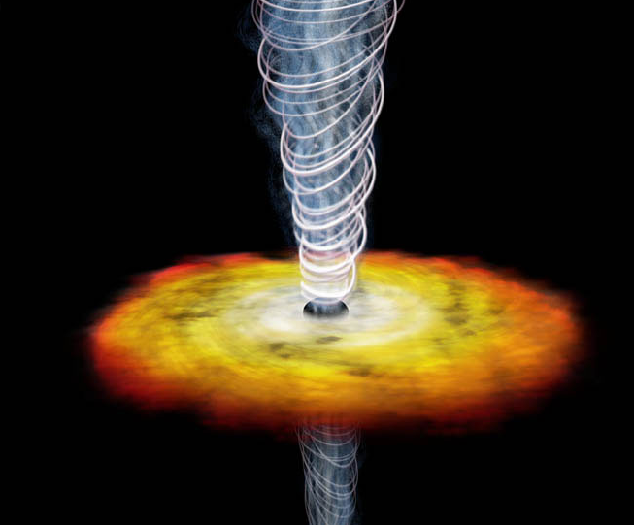
Astronomical objects
Quasar
Quasars was first discovered in 1960.
They emit electromagnetic radiation in the frequency bands corresponding to radio waves, ultraviolet, infrared, X-rays and gamma rays.
They are many light-years away from Earth and the radiation from a quasar could take billions of years to reach us and may carry signatures of the early stages of the universe.
Quasars are difficult to distinguish from stars due to their great distance from Earth.

Slide 8
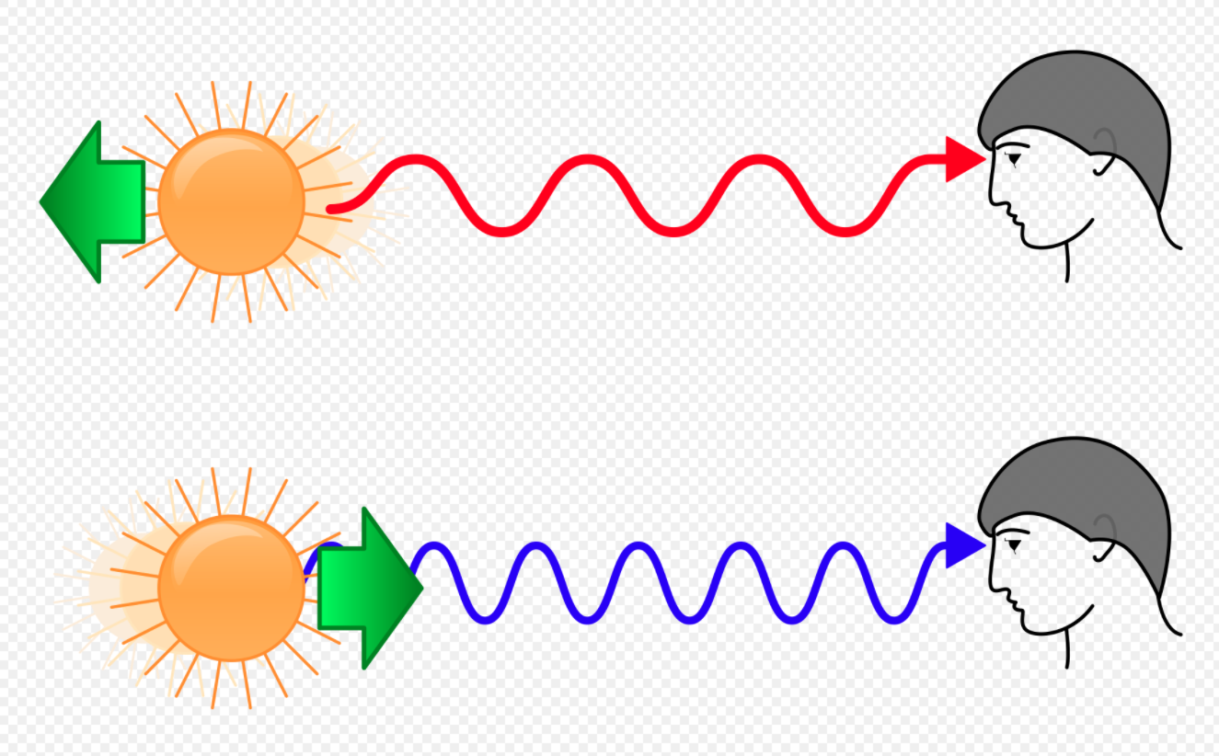
Redshift
Physical phenomenon that describes a state in which the frequency of light measured by an observer is lower than the frequency of light when emitted by the source. Most often this phenomenon occurs when the light source moves away quickly from the viewer, due to a physical effect known as the Doppler effect.
The redshift phenomenon is best known in the case of the spectrum emitted by distant galaxies shifted entirely to red.
The farther the galaxy, the greater the redshift. It was this discovery that led to the formulation of the Big Bang theory, according to which the entire universe erupted from one point of uniqueness and from there began to spread.

Slide 9
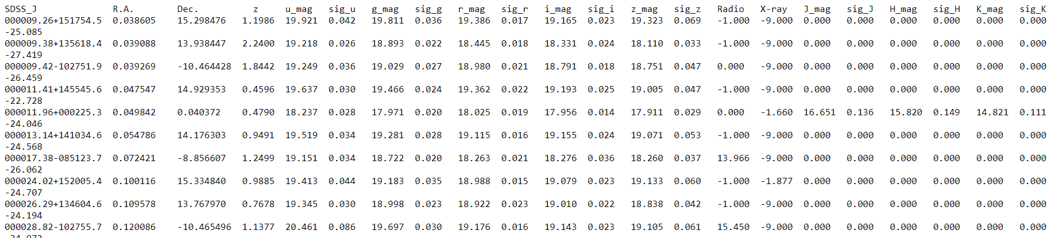
Machine learning Concepts
DataSEt
Random forest
Collection of data.
Corresponds to one or more database tables, where every column of a table represents a particular variable, and each row corresponds to a given record of the data set in question.
The data set lists values for each of the variables, such as mass and distance from Earth, for each member of the data set.
Collection of Decision trees.
Wisdom of the masses, send the challenge to multiple machine learning algorithms.
Combine the predictions together to make more accurate predictions than any individual model.
Some trees might be bigger than others.
Each tree has an equal vote on the final classification.
Notes:
The SDSS team has recently produced a catalog of 46,420 quasars from its 3rd Data Release, 95% of them previously unknown.
The dataset offered here is called SDSS_quasar.dat has all 46,420 rows but omits some technical columns.

Slide 10
Example
DataSet
Decision tree
Ring system | Moons | Mass | Type
0 | 0 | 0.06 | Terrestrial planet
0 | 0 | 0.82 | Terrestrial planet
0 | 1 | 1.00 | Terrestrial planet
1 | 66 | 317.8 | Gas giant
1 | 62 | 95.2 | Gas giant
1 | 27 | 19.22 | Gas giant
Moons
Mass > 1
none
exist
False
True
Ring system
Terrestrial planet
Terrestrial planet
Gas giant
none
exist
Terrestrial planet
Gas giant
Notes:
הטבלה המלאה - https://he.wikipedia.org/wiki/%D7%9B%D7%95%D7%9B%D7%91_%D7%9C%D7%9B%D7%AA

Slide 11
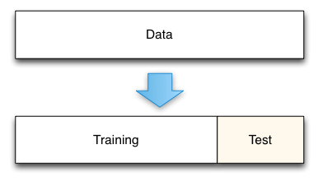
Training and testing data
In a dataset, a training set is implemented to build up a model, while a test set is to validate the model built. Data points in the training set are excluded from the test set.
In Machine Learning, we try to create a model to predict the test data. So, we use the training data to fit the model and testing data to test it. The models generated serve the purpose of predicting the unknown results.

Slide 12
Machine learning algorithms types
Unsupervised
Supervised
Unsupervised machine learning finds all kind of unknown patterns in data.
Unsupervised methods help you to find features which can be useful for categorization.
It is taken place in real time, so all the input data to be analyzed and labeled in the presence of learners.
It is easier to get unlabeled data from a computer than labeled data, which needs manual intervention.
Supervised learning allows you to collect data or produce a data output from the previous experience.
Helps you to optimize performance criteria using experience
Supervised machine learning helps you to solve various types of real-world computation problems.

Slide 13
02
incoming data
Telescopes and Spacecraft

Slide 14
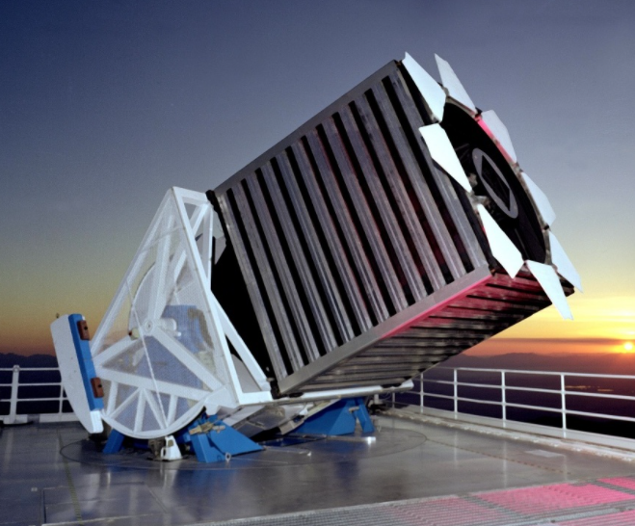
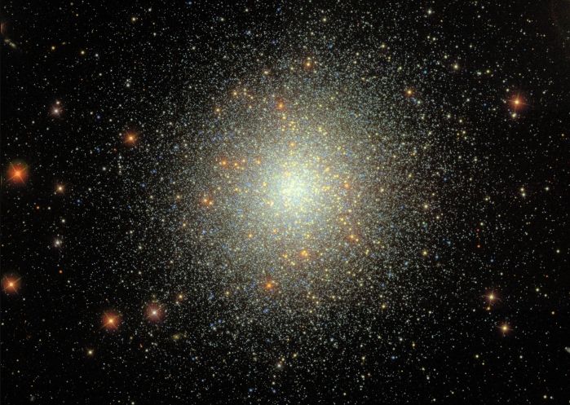
Sloan Digital Sky Survey (SDSS)
Is the most extensive redshift survey of the universe, whose data collection began on 1998.
Each night the telescope produces 200 GB of data, and to this day close to a million field images have been acquired, in which more than 200 million galaxies, and even more stars, have been detected.
From 1998 to 2009 it observed in both imaging (Images were taken using a photometric system) and spectroscopic modes. Since 2009 the telescope has observed entirely in spectroscopic mode.
Provides interfaces for querying and obtaining data as per a user’s needs. All of the data that is released by SDSS is available over the internet, for non-commercial use only.

Slide 15
Observations
Surveys usually make either Spectroscopic or Photometric observations:
Spectroscopy
Photometry
Measures the photon count at thousands of wavelengths. The resulting spectrum allows for identifying chemical components of the observed objects.
Spectroscopy drawbacks:
Distant or otherwise faint object cannot be measured.
Only a few objects can be captured at the same time.
Photometry is the science of the measurement of light, in terms of its perceived brightness to the human eye.
Can capture objects that may be ten times fainter than what can be measured with Spectroscopy.

Slide 16
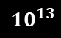
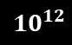
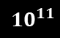
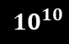
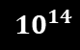
Increasing data volumes
$${10}^{14}$$
90 TB
30 TB
$${10}^{13}$$
$${10}^{12}$$
315 GB
200 GB
$${10}^{11}$$
10 GB
$${10}^{10}$$
Notes:
VLT – very large telescope
SDSS – Sloan Digital Sky Survey
VISTA – Visible and infrared telescope for astronomy
LSST – Large synoptic survey telescope
TMT – Thirty meter telescope

Slide 17
Nasa’s Kepler Spacecraft
Searching exoplanets from 2009 to 2018.
Observing light curves of stars, that is measuring a star’s brightness at regular intervals. The task is to look for changes in objects brightness indicating that a planet have moved in front of it – if that happens with regular period, duration and decrease in brightness the source is likely to be an exoplanet.
Much of the data for exoplanet discovery is publicly available. These include lights curves for confirmed exoplanets and false positive, making it a valuable dataset for testing detection algorithms.

Slide 18
03
Process data
Machine Learning Algorithms
SVM
SVM – KNN
AdaBoost
Asymmetric AdaBoost

Slide 19
Handling imbalanced datasets
Artificial Balancing
Separability test
Needs to be performed such that the classes present in the dataset used for training a model do not present a bias to the learning algorithm.
In the quasar-star classification, the stars class dominates the quasars class. This causes an increase in the influence of the stars class on the learning algorithm.
In artificial balancing, an equal number of samples from both the classes is taken in order to train the classifier. This eliminates the class bias and the data imbalance.
.
Used to determine the nature of the separability of data. In particular if the data are not linearly separable, certain classifiers may not work well or may not be appropriate.
.

Slide 20
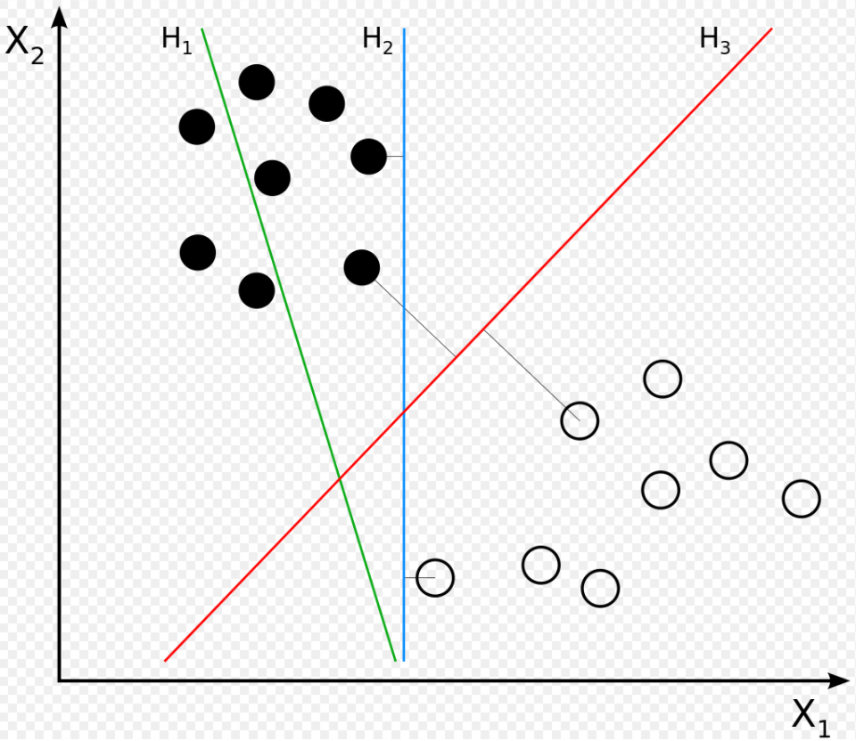
Algorithms
Support vector machine (SVM)
Requires the data to be separable so that it is possible to yield a hyperplane separating both classes. Consider a set on n samples from the dataset and two classes corresponding to quasars and stars.

Slide 21
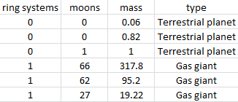
Code Example
# Load libraries
import pandas as pd
from sklearn import preprocessing
from sklearn import svm
from sklearn.model_selection import train_test_split
from sklearn.preprpcessong import StandarScaler
from sklearn.metrics import classification_report
# Read the csv file into the dataframe
df = pd.read_csv(“YourFileName.csv”)
# Transform all non numerical labels into numerical labels
encoder = preprocessing.LabelEncoder()
y_label = df.type
# Encoding labels
encoder.fit(y_label)
y = encoder.transform(y_label)
# Standardize the variables
scaler = StandarScaler()
features = df.drop([“type”], axis =1)
scaler.fit(features)
scaled_features = scaler.transform(features)
df_feat = pd.DataFrame(scaled_features, colums = df.colums[:-1])
# Split dataset into training set and test set
X = df_feat
X_train, X_test, y_train, y_test = train_test_split(X, y, test_size=0.3)
# 70% training and 30% test
# Using the SVM Model
linearCls = svm.SVC(gamma=‘auto’).set_params(kernel=‘linear’)
linearCls.fit(X_train, y_train)
# Use the model to predict the labels of the test data
linPred = linearCls.predict(X_test)
linPred_label = list(encoder.inverse_transform(linPred))
y_test_label = list(encoder.inverse_transform(y_test))
print(classification_report(y_test_label, linPred_label))
0
0
0
1
1
1

Slide 22
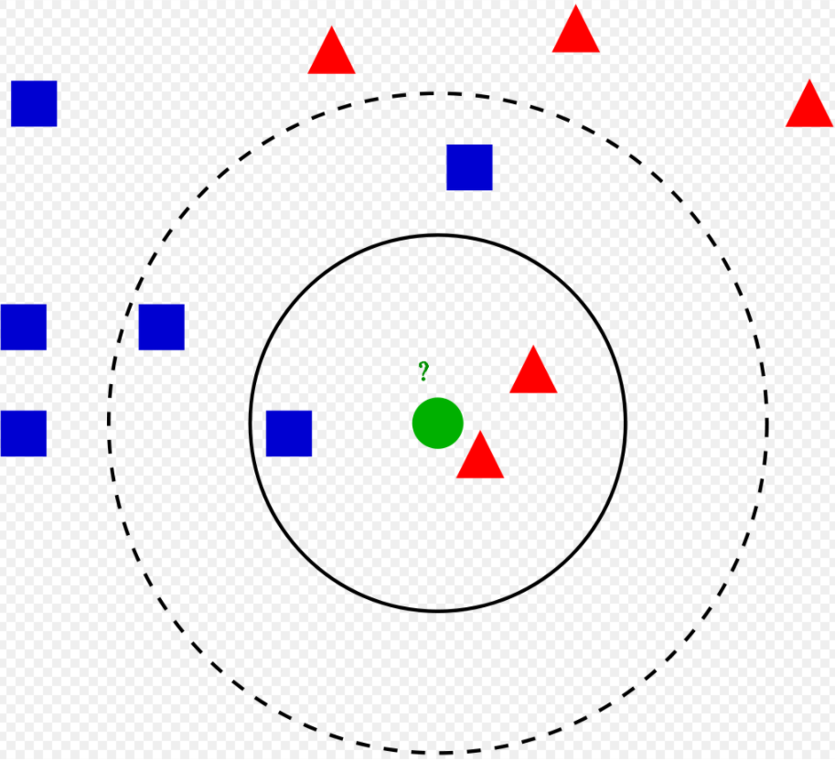
Algorithms
SVM – KNN (K-nearest neighbor)
Algorithm classification, based on geometric similarity of the K closest training samples in the feature space. The K closest samples may belong to different classes; the algorithms selects the class to which the majority belongs to.

Slide 23
Algorithms
Adaboost
In forest of trees made by AdaBoost, the trees are usually just a node and two leaves. A tree with just one node and two leaves is called stump.
Stumps can only use one variable to make a decision. Thus Stumps are “weak learners” Some stumps get more say in the final classification than others.
In a forest of Stumps made with AdaBoost order is important. The errors that the first stump makes influences how the second stump is made and etc.
General ensemble learning approach that makes use of the results of multiple weak learners to make a strong prediction. Works in multiple rounds by incrementally training weak learners, where each successive weak learner tries to classify the misclassified samples of the previous learner, with increased weights on the misclassified samples.

Slide 24
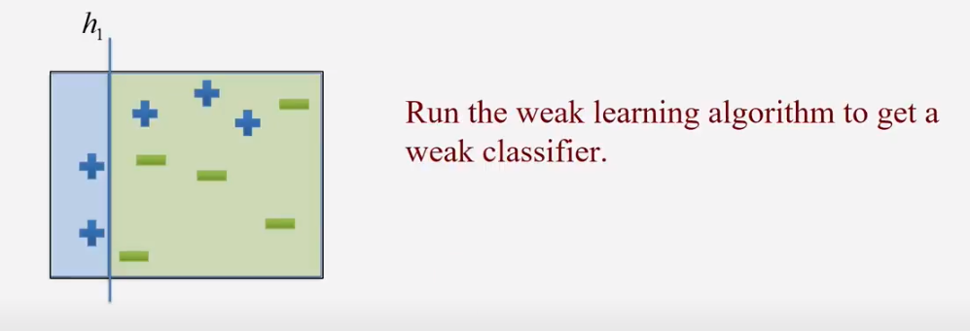
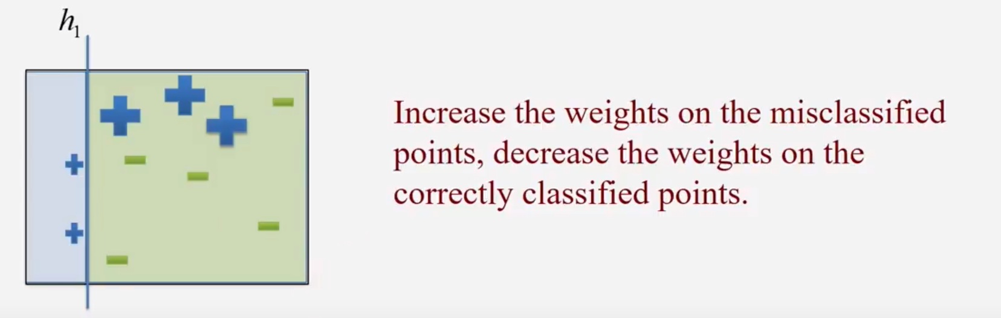
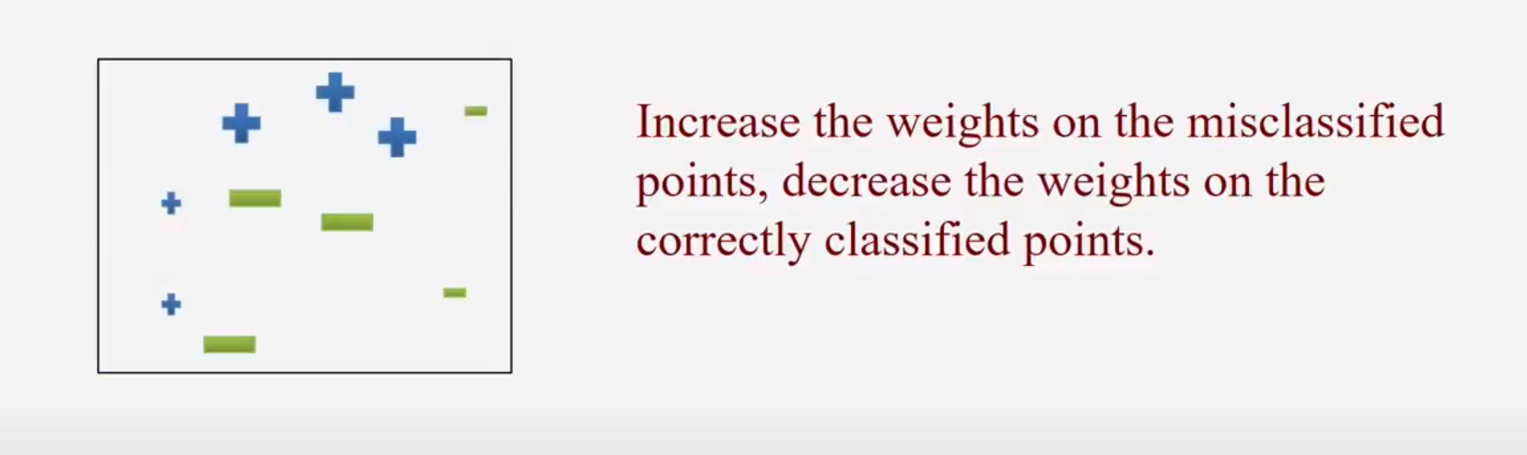
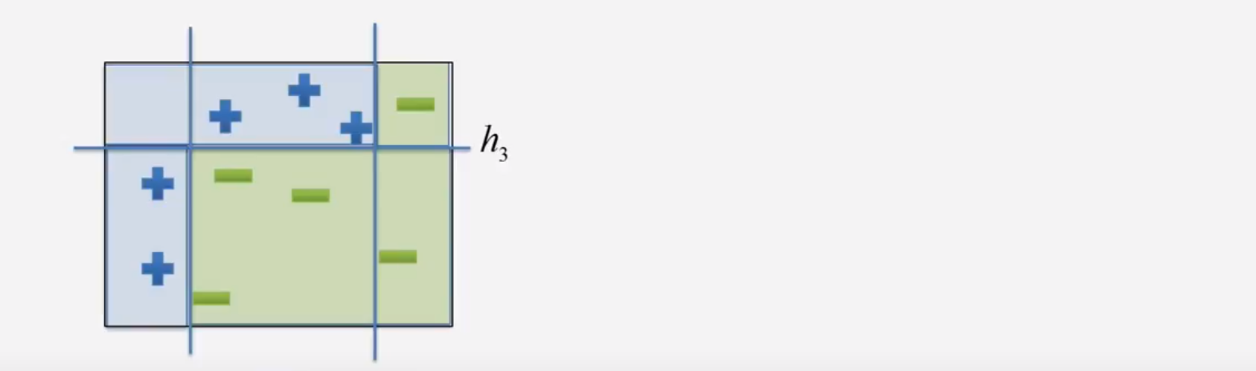
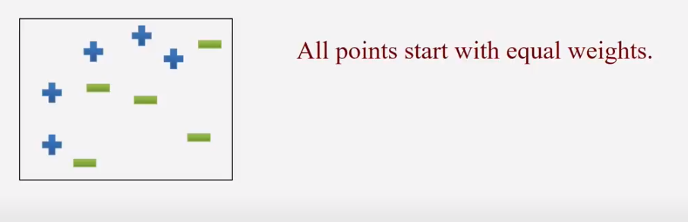
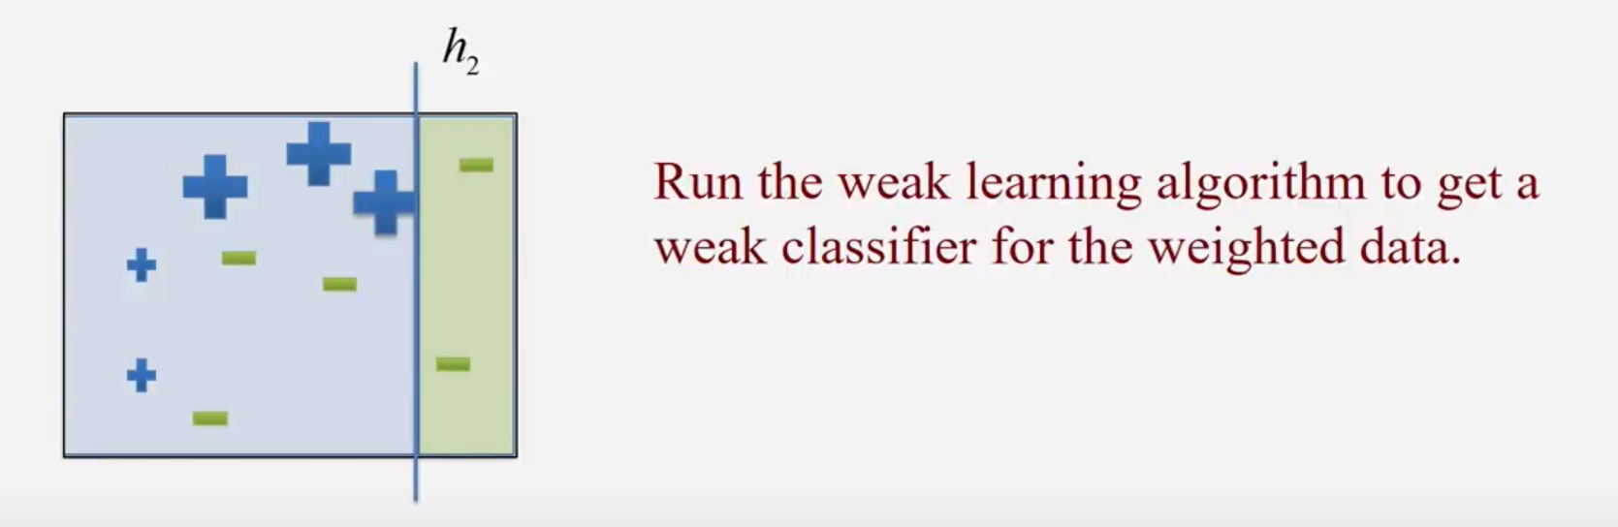
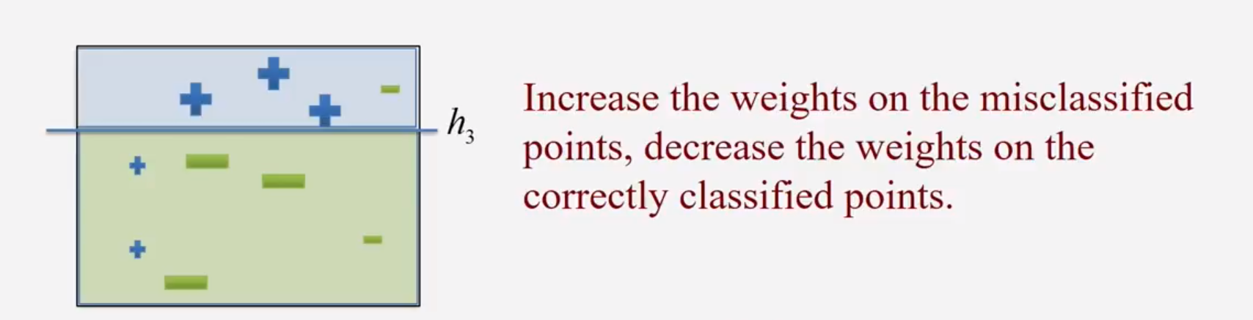
Example

Slide 25

Code Example
# Load libraries
from sklearn.ensemble import AdaBoostClassifier
from sklearn import datasets
# Import train_test_split function
from sklearn.model_selection import train_test_split
# Import scikit-learn metrics module for accuracy calculation
from sklearn import metrics
$$⋮$$
# Split dataset into training set and test set
X_train, X_test, y_train, y_test = train_test_split(X, y, test_size=0.3)
# 70% training and 30% test
# Create adaboost classifer object
abc = AdaBoostClassifier(n_estimators=50, learning_rate=1)
# Train Adaboost Classifer
model = abc.fit(X_train, y_train)
# Predict the response for test dataset
y_pred = model.predict(X_test)
# Model Accuracy, how often is the classifier correct?
print("Accuracy:", metrics.accuracy_score(y_test, y_pred))

Slide 26
Algorithms
Asymmetric Adaboost
Asymmetric AdaBoost aims to incorporate initial costs misclassification in order to make the AdaBoost algorithm more sensitive to biases.
In AdaBoost after each iteration, the weight distribution is modified in such a way that misclassified samples get a higher penalty than the correctly classified samples. While updating weights in successive iterations it treats the misclassification of positive samples and negative samples equally.
There may be situations where misclassification of a positive sample may be more expensive than that of a negative sample, which introduces an asymmetry to the problem.
Asymmetry can also be introduced when the number of samples belonging to one class dominates the other.

Slide 27
04
Classification
Distinguishing Stars from Quasars
Analysis of results

Slide 28
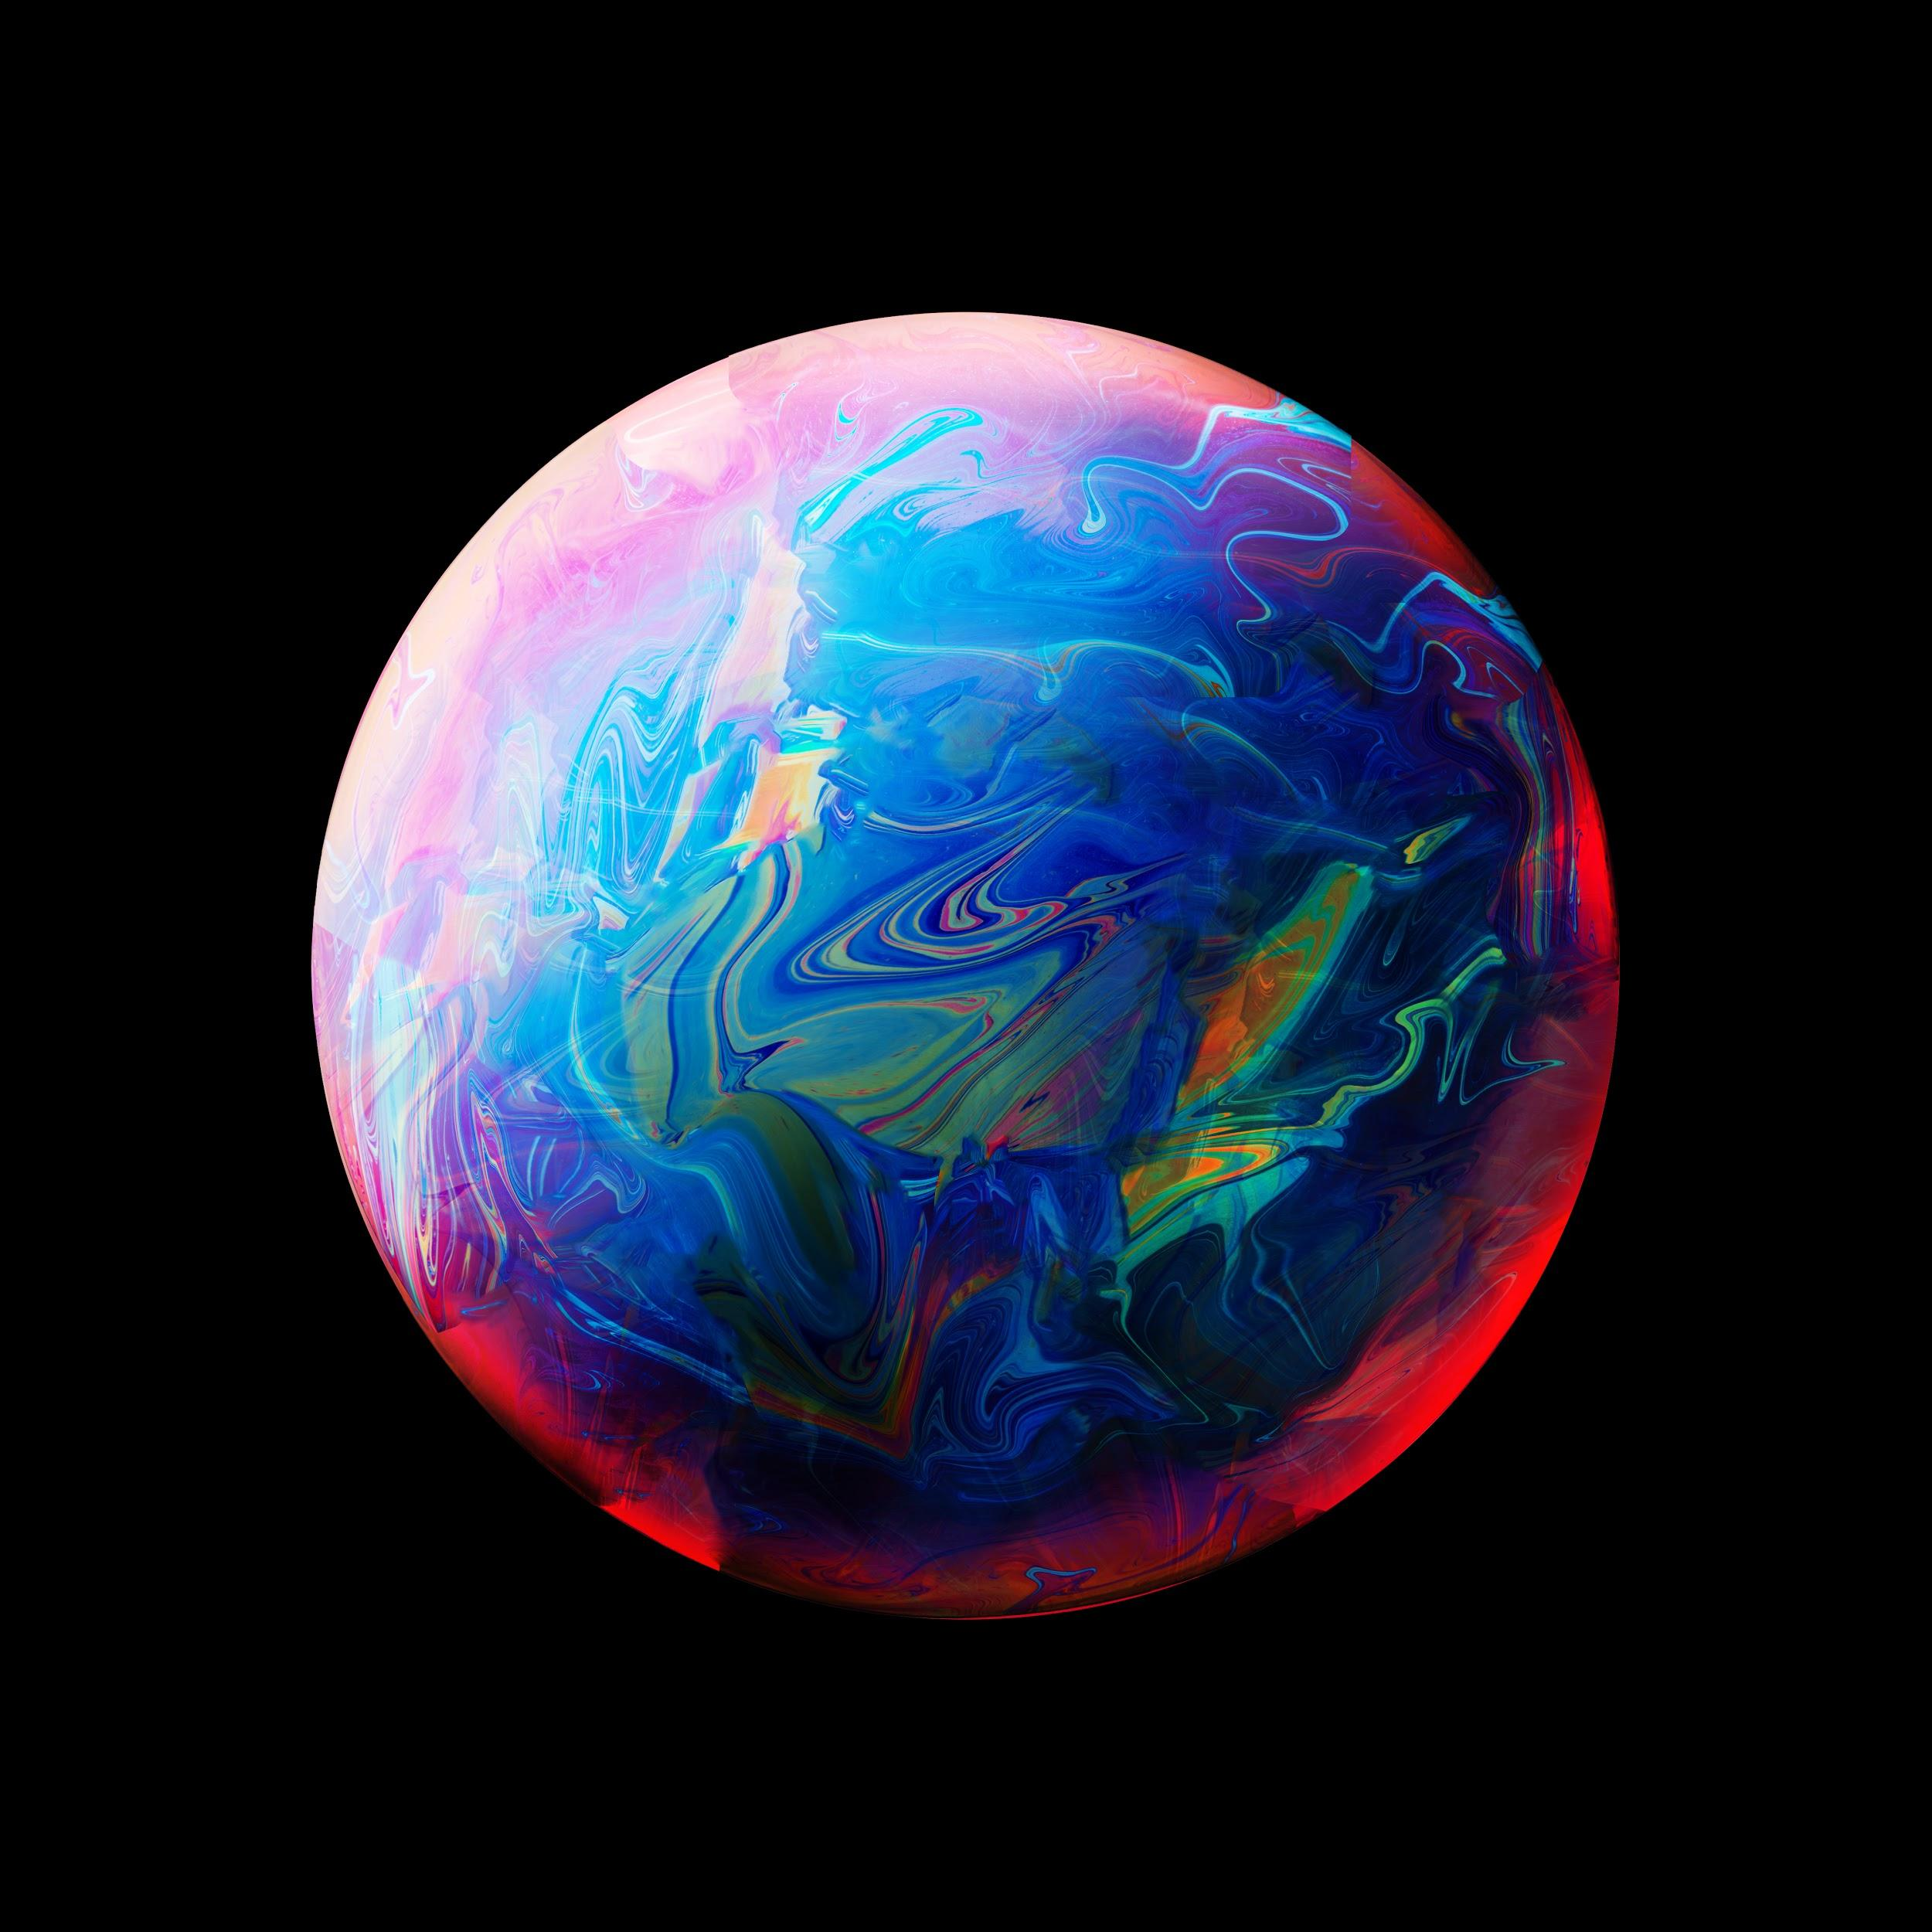
distinguishing stars from quasars
We checked classification methods, based on machine learning of objects from data releases of the SDSS.
Considering the redshift, we can observe that the data is considerably separable based on this feature. There's a slight overlap near the edge or corner point of the quasar class.
We tested the algorithms on a balanced dataset and on an unbalanced dataset.

Slide 29
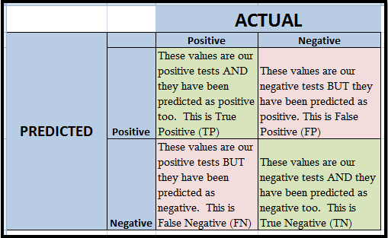
Evaluation of Classification
Accuracy = (TP + TN) / (TP + TN + FP + FN)
The higher the accuracy, the better the model
will be considered.
Sensitivity = TP / FN+TP
The ratio between how much were correctly identified as positive to how much were actually positive. Recall and sensitivity are one and the same.
Precision = TP/TP+FP
How much were correctly classified as positive
out of all positives.
Specificity = TN/FP+TN
The ratio between how much were correctly classified as negative to how much was actually negative.
Quasar
Star
Quasar
Star
Fscore = 2 * (precision * recall)/ (precision + recall)
F1 score is considered a better indicator of the classifier’s performance than the regular accuracy measure.

Slide 30
Results
Results of classification of
unbalanced dataset
Results of classification of
balanced dataset
Methods | Accuracy (%) | Sensitivity | Specificity | Fscore
SVM | 98.6 | 0.9150 | 0.9937 | 0.9551
SVM-KNN | 98.86 | 0.9159 | 1 | 0.9159
AdaBoost | 97.2 | 0.9012 | 0.9129 | 0.9406
Asymmetric AdaBoost | 99.99 | 1 | 1 | 1
Methods | Accuracy (%) | Sensitivity | Specificity
SVM | 96.92 | 0.9576 | 0.9808
SVM-KNN | 97.87 | 0.9575 | 1
AdaBoost | 96.54 | 0.9663 | 0.9645
Since the overlap is very little, SVM is an appropriate method to be explored as a classifier. However the slight overlap results in accuracy of 96.92% by SVM and not 100%.

Slide 31
Conclusion
Asymmetric AbaBoost is more efficient compared to other algorithms.
The approaches explored can be used to solve the star-quasar classification problem in particular, and other problems in astronomy in general.

Slide 32
Peek into the future
Within the next few years, image analysis and machine learning systems that can process terabytes of data in near real-time with high accuracy will be essential.
In this new data-rich era, astronomy and computer science benefit greatly from each other. There are new problems to be tackled, novel discoveries to be made, and above all, new knowledge to be gained in both fields.

Slide 33
THANKS!
Do you have any questions?

